Slide 1
Mining the Madden Experience
Applying Machine Learning to Telemetry
Ben Weber
UC Santa Cruz
bweber@soe.ucsc.edu
Michael John
Electronic Arts
mjohn@ea.com

Slide 2
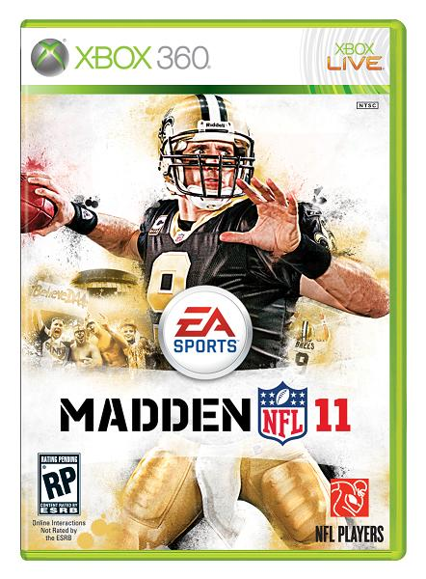
Madden NFL 11

Slide 3
Madden 2011 Questions
What gameplay features impact player retention?
What are optimal win rates for retention?

Slide 4
Our Problem
How do we identify the relation between gameplay features and retention?
Gameplay
Features
? ? ?
Player
Retention
Notes:
We are looking for something deeper than directly correlations between features and retention, because there may be complex interactions between variables. Also, there may be too much noise in the data if we look for association rules, such as “losing all of the first n games causes a player to quit”.

Slide 5
Our Solution
Use machine learning to build models of player behavior
Analyze generated models to identify influential gameplay elements

Slide 6
What is Machine Learning?
Machine Learning (ML) is branch of AI that uses algorithms to extract patterns from empirical data
ML is widely used for prediction and forecasting
Notes:
Specifically, we are using ML for a supervised prediction task.

Slide 7
What is a Model?
A function that maps input variables to a predicted value
Regression models predict a continuous value
Different ML algorithms generate different types of models
Notes:
We wanted to represent retention as a continuous value, number of games played. Didn’t list classification models, which predict the class (nominal value) of an instance.
I was planning to go into a bit more detail about different types of regression models, but decided to keep things on track and simple, and omit this section. Part of the appeal of using machine learning frameworks is that you do not have to be intimately familiar with the algorithms you are using.

Slide 8

What can a Model tell Us?
Model analysis can identify the most influential gameplay features
Analyst
Testing
Data
Feature
Tweaking
Model
Predictions
Notes:
Models can(should?) be thought of as a black box

Slide 9
How We Applied ML
Madden Players
Training
Data
Analyst
Testing
Data
ML Algorithms
Feature
Tweaking
Models
Predicted number of games played

Slide 10
Our Workflow
Madden
Gamecast
data
Java Parser
(ETL)
Weka
Notes:
Gamecast data files are XML. Although not entirely properly formatted xml.
Weka is a machine learning toolkit that provides a way for using off-the-shelf ML algorithms.
Rapid miner could be used as well for part of the ETL task.

Slide 11
Madden 2011 Gamecast Dataset
Gamecast telemetry
  Play-by-play summaries
  Xbox 360 players
  August 10th – November 1st
  350 GB
Sampled 25,000 players
Notes:
The majority of the data analyzed in this project was the gamecast summaries, which provide play-by-play information about every game played. We collected data from games played between August 10th and November 1st, focusing on the Xbox 360 version of the game.
We used a random sampling of players for performing our analysis. The sample size should be large enough to be representative of the player base. Additionally, 25,000 players is a much larger sample size than traditional user studies.

Slide 12
Extract-Transform-Load (ETL)
Parse play-by-play data
Convert to feature vector representation
Export to ARFF format
Notes:
A feature vector for our system was an array of float, where each array describes a single player.

Slide 13
ETL Workflow
Madden
Gamecast
data
User DB
Feature
Encoder
(Java)
Parser
(Java)
Play-by-Play Data
ARFF
Files
Notes:
Flat files -> MySQL -> flat files

Slide 14
Gameplay Features
Each player’s behavior is encoded as the following features (46 total):
Game modes
  Usage
  Win rates
Performance metrics
  Turnovers
  Gain
End conditions
  Completions
  Peer quits
Feature usage
  Gameflow
  Scouting
  Audibles
  Special moves
Play Preference
  Running
  Play Diversity

Slide 15
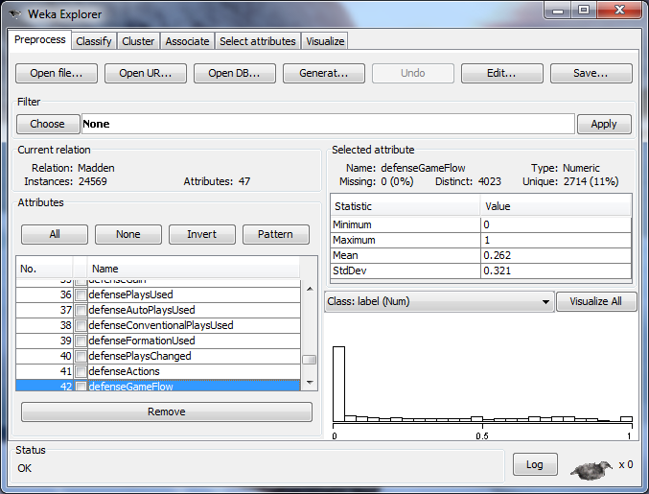
Weka Toolkit

Slide 16
Predicting the Number of Games Played

Slide 17
Feature Impact on Number of Games Played
How does tweaking a single feature impact retention?
Notes:
This is a sample of features from the M5’ regression tree predictor.

Slide 18
Most Influential Features
The following features were identified as the most influential in predicting player retention
Feature | Impact
Play Diversity | Negative
Online Franchise Wins | Positive
Running Plays | Positive
Sacks Made | Positive
Actions per Play | Positive
Interceptions Caught | Positive
Sacks Allowed | Negative
Peer Quit Ratio | Negative
Correlation Strength

Slide 19
Predicted Number of Games for Different Win Rates
Notes:
For a player that plays a single mode only.
This analysis shows clearly the difference in player expectation between playing a human (online) versus an AI (Franchise, Superstar). Win rates in the 75% range produce the strongest predicted retention for the single player modes, whereas a 50% win rate is strongest for multiplayer.

Slide 20
What We Learned
Simplify playbooks
  Players presented with a large variety of plays have lower retention and less success
Clearly present the controls
  Knowledge of controls had a larger impact than winning on player retention
Provide the correct challenge
  Multiplayer matches should be as even as possible, while single player should greatly favor the player

Slide 21
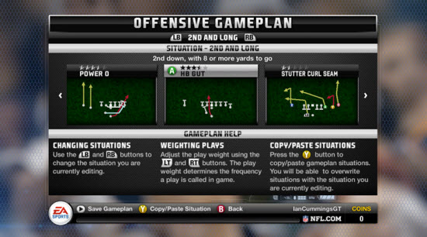
Project Impact
Play selection redesign

Slide 22
Takeaways
Machine Learning enables deep analysis of Big Data
Machine Learning is versatile
There are open tools
Notes:
Caveats
Beware of overfitting
In statistics, correlation does not imply causality

Slide 23


Questions?
Ben Weber
  UC Santa Cruz
  bweber@soe.ucsc.edu
Michael John
  Electronic Arts
  mjohn@ea.com

